Slide 1
Weighted Automata
Smayan Agarwal | 9th February 2026 | Theory of Computation

Slide 2
Definition and Examples
$$b/2$$
$$q_{1}$$
$$q_{2}$$
$$a/1$$
$$a/2$$
$$1$$
$$q_{0}$$
$$a/3$$
$$q_{4}$$
$$2$$
$$q_{3}$$
$$a/2$$
$$a/5$$
$$b/3$$
$$b/{0.5}$$

Slide 3
Definition and Examples
$$b/2$$
$$q_{1}$$
$$q_{2}$$
$$a/1$$
$$a/2$$
$$1$$
$$q_{0}$$
$$a/3$$
$$q_{4}$$
$$2$$
$$q_{3}$$
$$a/2$$
$$a/5$$
$$b/3$$
$$b/{0.5}$$
$$A(ba)=?$$

Slide 4
Definition and Examples
$$b/2$$
$$q_{1}$$
$$q_{2}$$
$$a/1$$
$$a/2$$
$$1$$
$$q_{0}$$
$$a/3$$
$$q_{4}$$
$$2$$
$$q_{3}$$
$$a/2$$
$$a/5$$
$$b/3$$
$$b/{0.5}$$
$$A(ba)=1×?$$

Slide 5
Definition and Examples
$$b/2$$
$$q_{1}$$
$$q_{2}$$
$$a/1$$
$$a/2$$
$$1$$
$$q_{0}$$
$$a/3$$
$$q_{4}$$
$$2$$
$$q_{3}$$
$$a/2$$
$$a/5$$
$$b/3$$
$$b/{0.5}$$
$$A(ba)=1×3$$

Slide 6
Definition and Examples
$$b/2$$
$$q_{1}$$
$$q_{2}$$
$$a/1$$
$$a/2$$
$$1$$
$$q_{0}$$
$$a/3$$
$$q_{4}$$
$$2$$
$$q_{3}$$
$$a/2$$
$$a/5$$
$$b/3$$
$$b/{0.5}$$
$$A(ba)=1×3×5×?$$

Slide 7
Definition and Examples
$$b/2$$
$$q_{1}$$
$$q_{2}$$
$$a/1$$
$$a/2$$
$$1$$
$$q_{0}$$
$$a/3$$
$$q_{4}$$
$$2$$
$$q_{3}$$
$$a/2$$
$$a/5$$
$$b/3$$
$$b/{0.5}$$
$$A(ba)=1×3×5×2=30$$

Slide 8
Definition and Examples
$$b/2$$
$$q_{1}$$
$$q_{2}$$
$$a/1$$
$$a/2$$
$$1$$
$$q_{0}$$
$$a/3$$
$$q_{4}$$
$$2$$
$$q_{3}$$
$$a/2$$
$$a/5$$
$$b/3$$
$$b/{0.5}$$
$$A(aba)=1×?$$

Slide 9
Definition and Examples
$$b/2$$
$$q_{1}$$
$$q_{2}$$
$$a/1$$
$$a/2$$
$$1$$
$$q_{0}$$
$$a/3$$
$$q_{4}$$
$$2$$
$$q_{3}$$
$$a/2$$
$$a/5$$
$$b/3$$
$$b/{0.5}$$
$$A(aba)=1×?$$

Slide 10
Definition and Examples
$$b/2$$
$$q_{1}$$
$$q_{2}$$
$$a/1$$
$$a/2$$
$$1$$
$$q_{0}$$
$$a/3$$
$$q_{4}$$
$$2$$
$$q_{3}$$
$$a/2$$
$$a/5$$
$$b/3$$
$$b/{0.5}$$
$$A(aba)=1×2×?$$

Slide 11
Definition and Examples
$$b/2$$
$$q_{1}$$
$$q_{2}$$
$$a/1$$
$$a/2$$
$$1$$
$$q_{0}$$
$$a/3$$
$$q_{4}$$
$$2$$
$$q_{3}$$
$$a/2$$
$$a/5$$
$$b/3$$
$$b/{0.5}$$
$$A(aba)=1×2×0.5×?$$

Slide 12
Definition and Examples
$$b/2$$
$$q_{1}$$
$$q_{2}$$
$$a/1$$
$$a/2$$
$$1$$
$$q_{0}$$
$$a/3$$
$$q_{4}$$
$$2$$
$$q_{3}$$
$$a/2$$
$$a/5$$
$$b/3$$
$$b/{0.5}$$
$$A(aba)=1×2×0.5×5×2=10$$

Slide 13
Definition and Examples
$$b/2$$
$$q_{1}$$
$$q_{2}$$
$$a/1$$
$$a/2$$
$$1$$
$$q_{0}$$
$$a/3$$
$$q_{4}$$
$$2$$
$$q_{3}$$
$$a/2$$
$$a/5$$
$$b/3$$
$$b/{0.5}$$
$$A(aba)=10,1×2×?$$

Slide 14
Definition and Examples
$$b/2$$
$$q_{1}$$
$$q_{2}$$
$$a/1$$
$$a/2$$
$$1$$
$$q_{0}$$
$$a/3$$
$$q_{4}$$
$$2$$
$$q_{3}$$
$$a/2$$
$$a/5$$
$$b/3$$
$$b/{0.5}$$
$$A(aba)=10,1×2×2×?$$

Slide 15
Definition and Examples
$$b/2$$
$$q_{1}$$
$$q_{2}$$
$$a/1$$
$$a/2$$
$$1$$
$$q_{0}$$
$$a/3$$
$$q_{4}$$
$$2$$
$$q_{3}$$
$$a/2$$
$$a/5$$
$$b/3$$
$$b/{0.5}$$
$$A(aba)=10,1×2×2×1×2=8$$

Slide 16
Definition and Examples
$$b/2$$
$$q_{1}$$
$$q_{2}$$
$$a/1$$
$$a/2$$
$$1$$
$$q_{0}$$
$$a/3$$
$$q_{4}$$
$$2$$
$$q_{3}$$
$$a/2$$
$$a/5$$
$$b/3$$
$$b/{0.5}$$
$$A(aba)=10+8=18$$

Slide 17
$$q_{1}$$
$$A/3$$
$$1$$
$$2$$
$$q_{0}$$
$$q_{4}$$
$$B/2$$
$$A/2$$
$$q_{2}$$
$$q_{3}$$
$$A/3$$

Slide 18
Definitions & Examples
A Weighted Automata over the real numbers is a 5-tuple:
$A=(Q,Σ,δ,s,F)$, where:
1. $Q$ is a finite set of states
2. $Σ$ is a finite alphabet
3. $M:Q×Σ×Q→R$ is the transition function
4. $μ:Q→R$ is an initial state function , and
5. $λ:Q→R$ is the final state function.

Slide 19
Definitions & Examples
Let $w=w_{1}w_{2}…w_{n}∈Σ^{*}$
A run of $A$ on $w$ is the sequence $π=(q_{0},q_{1},…,q_{n})∈Q^{n+1}$
The weight of the run $π$ on $w$ is $wt(π)=μ(q_{0})⋅(Π_{i=1}^{n}M_{a_{i}}(q_{i-1},a_{i},q_{i})⋅λ(q_{n})$
The weight assigned to a word $w$ is the sum over all runs
$$A(w)=\underset{π_{i}}{∑}wt(π_{i})$$

Slide 20
Definitions & Examples
Let $w=w_{1}w_{2}…w_{n}∈Σ^{*}$
A run of $A$ on $w$ is the sequence $π=(q_{0},q_{1},…,q_{n})∈Q^{n+1}$
The weight of the run $π$ on $w$ is $wt(π)=μ(q_{0})⊗(\overset{n}{\underset{i=1}{⨀}}M_{a_{i}}(q_{i-1},a_{i},q_{i})⊗λ(q_{n})$
The weight assigned to a word $w$ is the sum over all runs
$$A(w)=\underset{π_{i}}{⨁}wt(π_{i})$$

Slide 21
Definitions & Examples
$$b/2$$
Let us consider an alternate type of machine
Instead of addition, we have the min
Instead of multiplication, we have addition
$$q_{1}$$
$$q_{2}$$
$$a/1$$
$$a/2$$
$$3$$
$$q_{0}$$
$$b/3$$
$$q_{4}$$
$$2$$
$$q_{3}$$
$$a/5$$
$$a/5$$
$$a/2$$
$$a/5$$
$$a,b/0$$
$$b/3$$

Slide 22
Definitions & Examples
$$b/2$$
Let us consider an alternate type of machine
Instead of addition, we have the min
Instead of multiplication, we have addition
$$q_{1}$$
$$q_{2}$$
$$a/1$$
$$a/2$$
$$3$$
$$q_{0}$$
$$b/3$$
$$q_{4}$$
$$2$$
$$q_{3}$$
$$a/5$$
$$a/5$$
$$a/2$$
$$a/5$$
$$a,b/0$$
$$b/3$$
$$A(ba)=?$$

Slide 23
Definitions & Examples
$$b/2$$
Let us consider an alternate type of machine
Instead of addition, we have the min
Instead of multiplication, we have addition
$$q_{1}$$
$$q_{2}$$
$$a/1$$
$$a/2$$
$$3$$
$$q_{0}$$
$$b/3$$
$$q_{4}$$
$$2$$
$$q_{3}$$
$$a/5$$
$$a/5$$
$$a/2$$
$$a/5$$
$$a,b/0$$
$$b/3$$
$$A(ba)=3+?$$

Slide 24
Definitions & Examples
$$b/2$$
Let us consider an alternate type of machine
Instead of addition, we have the min
Instead of multiplication, we have addition
$$q_{1}$$
$$q_{2}$$
$$a/1$$
$$a/2$$
$$3$$
$$q_{0}$$
$$b/3$$
$$q_{4}$$
$$2$$
$$q_{3}$$
$$a/5$$
$$a/5$$
$$a/2$$
$$a/5$$
$$a,b/0$$
$$b/3$$
$$A(ba)=3+3+?$$

Slide 25
Definitions & Examples
$$b/2$$
Let us consider an alternate type of machine
Instead of addition, we have the min
Instead of multiplication, we have addition
$$q_{1}$$
$$q_{2}$$
$$a/1$$
$$a/2$$
$$3$$
$$q_{0}$$
$$b/3$$
$$q_{4}$$
$$2$$
$$q_{3}$$
$$a/5$$
$$a/5$$
$$a/2$$
$$a/5$$
$$a,b/0$$
$$b/3$$
$$A(ba)=3+3+5+?$$

Slide 26
Definitions & Examples
$$b/2$$
Let us consider an alternate type of machine
Instead of addition, we have the min
Instead of multiplication, we have addition
$$q_{1}$$
$$q_{2}$$
$$a/1$$
$$a/2$$
$$3$$
$$q_{0}$$
$$b/3$$
$$q_{4}$$
$$2$$
$$q_{3}$$
$$a/5$$
$$a/5$$
$$a/2$$
$$a/5$$
$$a,b/0$$
$$b/3$$
$$A(ba)=3+3+5+2=13$$

Slide 27
Definitions & Examples
$$b/2$$
Let us consider an alternate type of machine
Instead of addition, we have the min
Instead of multiplication, we have addition
$$q_{1}$$
$$q_{2}$$
$$a/1$$
$$a/2$$
$$3$$
$$q_{0}$$
$$b/3$$
$$q_{4}$$
$$2$$
$$q_{3}$$
$$a/5$$
$$a/5$$
$$a/2$$
$$a/5$$
$$a,b/0$$
$$b/3$$
$$A(ababa)=?$$

Slide 28
Definitions & Examples
$$b/2$$
Let us consider an alternate type of machine
Instead of addition, we have the min
Instead of multiplication, we have addition
$$q_{1}$$
$$q_{2}$$
$$a/1$$
$$a/2$$
$$3$$
$$q_{0}$$
$$b/3$$
$$q_{4}$$
$$2$$
$$q_{3}$$
$$a/5$$
$$a/5$$
$$a/2$$
$$a/5$$
$$a,b/0$$
$$b/3$$
$$A(ababa)=3+?$$

Slide 29
Definitions & Examples
$$b/2$$
Let us consider an alternate type of machine
Instead of addition, we have the min
Instead of multiplication, we have addition
$$q_{1}$$
$$q_{2}$$
$$a/1$$
$$a/2$$
$$3$$
$$q_{0}$$
$$b/3$$
$$q_{4}$$
$$2$$
$$q_{3}$$
$$a/5$$
$$a/5$$
$$a/2$$
$$a/5$$
$$a,b/0$$
$$b/3$$
$$A(ababa)=3+2+?$$

Slide 30
Definitions & Examples
$$b/2$$
Let us consider an alternate type of machine
Instead of addition, we have the min
Instead of multiplication, we have addition
$$q_{1}$$
$$q_{2}$$
$$a/1$$
$$a/2$$
$$3$$
$$q_{0}$$
$$b/3$$
$$q_{4}$$
$$2$$
$$q_{3}$$
$$a/5$$
$$a/5$$
$$a/2$$
$$a/5$$
$$a,b/0$$
$$b/3$$
$$A(ababa)=3+2+3+2+2+1+2=15$$

Slide 31
Definitions & Examples
$$b/2$$
Let us consider an alternate type of machine
Instead of addition, we have the min
Instead of multiplication, we have addition
$$q_{1}$$
$$q_{2}$$
$$a/1$$
$$a/2$$
$$3$$
$$q_{0}$$
$$b/3$$
$$q_{4}$$
$$2$$
$$q_{3}$$
$$a/5$$
$$a/5$$
$$a/2$$
$$a/5$$
$$a,b/0$$
$$b/3$$
$$A(ababa)=15,3+2+2+1+0+0+2=10$$

Slide 32
Definitions & Examples
$$b/2$$
Let us consider an alternate type of machine
Instead of addition, we have the min
Instead of multiplication, we have addition
$$q_{1}$$
$$q_{2}$$
$$a/1$$
$$a/2$$
$$3$$
$$q_{0}$$
$$b/3$$
$$q_{4}$$
$$2$$
$$q_{3}$$
$$a/5$$
$$a/5$$
$$a/2$$
$$a/5$$
$$a,b/0$$
$$b/3$$
$$A(ababa)=min(15,10)=10$$

Slide 33
Matrix Multiplication Algorithms
$$b/1$$
$$M_{a}=\left(\begin{matrix}0 & 5 & 0 \\ 0 & 0 & 2 \\ 1.5 & 0 & 0\end{matrix}\right)$$
$$3$$
$$a/5$$
$$q_{1}$$
$$b/2$$
$$2$$
$$q_{0}$$
$$b/{0.5}$$
$$a/2$$
$$q_{2}$$
$$a/{1.5}$$
$$1$$

Slide 34
Matrix Multiplication Algorithms
$$b/1$$
$$M_{a}=\left(\begin{matrix}0 & 5 & 0 \\ 0 & 0 & 2 \\ 1.5 & 0 & 0\end{matrix}\right)M_{b}=\left(\begin{matrix}2 & 0 & 0 \\ 0 & 1 & 0 \\ 0 & 0 & 0.5\end{matrix}\right)$$
$$3$$
$$a/5$$
$$q_{1}$$
$$b/2$$
$$2$$
$$q_{0}$$
$$b/{0.5}$$
$$a/2$$
$$q_{2}$$
$$a/{1.5}$$
$$1$$

Slide 35
Matrix Multiplication Algorithms
$$b/1$$
$$M_{a}=\left(\begin{matrix}0 & 5 & 0 \\ 0 & 0 & 2 \\ 1.5 & 0 & 0\end{matrix}\right)M_{b}=\left(\begin{matrix}2 & 0 & 0 \\ 0 & 1 & 0 \\ 0 & 0 & 0.5\end{matrix}\right)$$
$$3$$
$$a/5$$
$$q_{1}$$
$$b/2$$
$$2$$
$$q_{0}$$
$$b/{0.5}$$
$$a/2$$
$$μ=\left(\begin{matrix}2 & 0 & 0\end{matrix}\right)λ=\left(\begin{aligned}0 \\ 3 \\ 1\end{aligned}\right)$$
$$q_{2}$$
$$a/{1.5}$$
$$1$$

Slide 36
Matrix Multiplication Algorithms
$$b/1$$
Now let us consider the matrix
multiplication algorithm to find
the weight of the word $aba$
$$A(aba)=μ⋅M_{a}⋅M_{b}⋅M_{a}⋅λ$$
$$=\left(\begin{matrix}2 & 0 & 0\end{matrix}\right)⋅\left(\begin{matrix}0 & 5 & 0 \\ 0 & 0 & 2 \\ 1.5 & 0 & 0\end{matrix}\right)⋅\left(\begin{matrix}2 & 0 & 0 \\ 0 & 1 & 0 \\ 0 & 0 & 0.5\end{matrix}\right)⋅\left(\begin{matrix}0 & 5 & 0 \\ 0 & 0 & 2 \\ 1.5 & 0 & 0\end{matrix}\right)\left(\begin{aligned}0 \\ 3 \\ 1\end{aligned}\right)$$
= 20
$$3$$
$$a/5$$
$$q_{1}$$
$$b/2$$
$$2$$
$$q_{0}$$
$$b/{0.5}$$
$$a/2$$
$$q_{2}$$
$$a/{1.5}$$
$$1$$

Slide 37
Matrix Multiplication Algorithms
A Weighted Automata over the real numbers is a 5-tuple:
$A=(Q,Σ,δ,s,F)$, where:
1. $Q$ is a finite set of states
2. $Σ$ is a finite alphabet
3. $\{M_{a}\}_{a∈Σ}∈R^{n×n}$ is the transition function for each letter $a∈Σ$.
4. $μ∈R^{1×n}$ is an initial state function , and
5. $λ∈R^{n×1}$ is the final state function.

Slide 38
Non-deterministic WA $≠$ Deterministic WA
$$a/0$$
$$b/1$$
$$Σ=\{a,b\}$$
$$A:Σ^{*}→R$$
$$A:a^{n}b^{m}↦min(n,m)$$
$$0$$
$$ε$$
$$0$$
$$0$$
$$ε$$
$$a/1$$
$$b/0$$

Slide 39
Non-deterministic WA $≠$ Deterministic WA
Why can this not be made deterministic?
At the beginning we enter two mode and then we take the minimum of the two modes.
Minimum is a non-linear function and in a deterministic machine you cannot make use of it directly
$$b/1$$
$$0$$
$$ε$$
$$0$$
$$0$$
$$ε$$
$$a/1$$

Slide 40
Non-deterministic WA $≠$ Deterministic WA
$$a/0$$
$$b/1$$
$$Σ=\{a,b\}$$
$$A:Σ^{*}→R$$
$$A:a^{n}b^{m}↦min(n,m)$$
$$0$$
$$ε$$
$$0$$
$$0$$
$$ε$$
$$a/1$$
$$b/0$$

Slide 41
Non-deterministic WA $≠$ Deterministic WA
$$A:Σ^{*}→R$$
$$A:w↦(w)_{ab}$$
$$A(abab)=?$$
$$A(aaaab)=?$$
$$A(bbba)=?$$
$$a/1$$
$$a/1$$
$$b/1$$
$$b/1$$
$$1$$
$$a/1$$
$$b/1$$
$$1$$
$$q_{0}$$
$$q_{1}$$
$$q_{2}$$

Slide 42
Non-deterministic WA $≠$ Deterministic WA
Why can this not be made deterministic?
Every run has weight 1, every accepting run corresponds to an incidence of $ab$.
Determinism requires that for each word there be only one run.
$$a/1$$
$$a/1$$
$$b/1$$
$$b/1$$
$$1$$
$$a/1$$
$$b/1$$
$$1$$
$$q_{0}$$
$$q_{1}$$
$$q_{2}$$

Slide 43
Closure Properties
Sum
Weighted Automata are closed under union

Slide 44
Closure Properties
Sum
Weighted Automata are closed under union
Rational Series are closed under sum operation.

Slide 45
Closure Properties
Sum
Weighted Automata are closed under union
Rational Series are closed under sum operation.
How? Create a new start state and add $ε/1$ transitions to the $S$ and $T$ automatons

Slide 46
Closure Properties
Sum
Weighted Automata are closed under union
Rational Series are closed under sum operation.
How? Create a new start state and add $ε/1$ transitions to the $S$ and $T$ automatons
If $S,T:Σ^{*}→R$ are recognised by Weighted Automata,
then $S+T:Σ^{*}→R$ is also recognised by Weighted Automata
$$S+T:Σ^{*}→R$$
$$S+T:w↦S(w)+T(w)$$

Slide 47
Closure Properties
Sum
Weighted Automata are closed under union
Rational Series are closed under sum operation.
How? Create a new start state and add $ε/1$ transitions to the $S$ and $T$ automatons
If $S,T:Σ^{*}→R$ are recognised by Weighted Automata,
then $S+T:Σ^{*}→R$ is also recognised by Weighted Automata
$$S+T:Σ^{*}→R$$
$$S+T:w↦S(w)⊕T(w)$$

Slide 48
Closure Properties
Cauchy Product
Weighted Automata are closed under concatenation

Slide 49
Closure Properties
Cauchy Product
Weighted Automata are closed under concatenation
Rational Series are closed under Cauchy product operation.

Slide 50
Closure Properties
Cauchy Product
Weighted Automata are closed under concatenation
Rational Series are closed under Cauchy product operation.
How? Connect all the final states of $S$ to the starting states of $T$ with $ε/1$ transitions

Slide 51
Closure Properties
Cauchy Product
Weighted Automata are closed under concatenation
Rational Series are closed under Cauchy product operation.
How? Connect all the final states of $S$ to the starting states of $T$ with $ε/1$ transitions
If $S,T:Σ^{*}→R$ are recognised by Weighted Automata,
then $S⋅T:Σ^{*}→R$ is also recognised by Weighted Automata
$$S⋅T:Σ^{*}→R$$
$$S⋅T:w↦\underset{w=u⋅v}{∑}S(u)⋅T(v)$$

Slide 52
Closure Properties
Cauchy Product
Weighted Automata are closed under concatenation
Rational Series are closed under Cauchy product operation.
How? Connect all the final states of $S$ to the starting states of $T$ with $ε/1$ transitions
If $S,T:Σ^{*}→R$ are recognised by Weighted Automata,
then $S⋅T:Σ^{*}→R$ is also recognised by Weighted Automata
$$S⋅T:Σ^{*}→R$$
$$S⋅T:w↦\underset{w=u⋅v}{⨁}S(u)⊗T(v)$$

Slide 53
Closure Properties
Kleene star
Rational Series are closed under Kleene star operation.
How? Connect all the final states of $S$ to the starting states of $S$ with $ε/1$ transitions
If $S:Σ^{*}→R$ is recognised by a Weighted Automata,
then $S^{*}:Σ^{*}→R$ is also recognised by Weighted Automata
$$S⋅T:Σ^{*}→R$$
$$S^{*}:w↦\underset{n≥0}{⨁}S^{n}(w)$$

Slide 54
Closure Properties
Other Fun Closure Properties
Closure under Hadamard Product operation.
$$S⊙T:w↦S(w)⊗T(w)$$

Slide 55
Closure Properties
Other Fun Closure Properties
Closure under Hadamard Product operation.
$$S⊙T:w↦S(w)⊗T(w)$$
Closure under Scalar Multiplication operation
$$αS(w):w↦α⊗S(w)$$

Slide 56
Closure Properties
Other Fun Closure Properties
Closure under Hadamard Product operation.
$$S⊙T:w↦S(w)⊗T(w)$$
Closure under Scalar Multiplication operation
$$αS(w):w↦α⊗S(w)$$
Closure under Left Quotient operation
$$u^{-1}S:w↦S(uw)$$

Slide 57
Closure Properties
Other Fun Non-Closure Properties
Not closed under Complementation operation.

Slide 58
Closure Properties
Other Fun Non-Closure Properties
Not closed under Complementation operation.
What does complementation even mean in the context of functions?

Slide 59
Decision Problems
Given a positive-rational automata $A$, tell whether it has universal support.
$$∀wA(w)≠0$$

Slide 60
Decision Problems
Given a positive-rational automata $A$, tell whether it has universal support.
$$∀wA(w)≠0$$
Not decidable.

Slide 61
Decision Problems
Given a positive-rational automata $A$, tell whether it has universal support.
$$∀wA(w)≠0$$
Not decidable.
Given two min-cost automata $A\text{and}B$, tell whether both of them define the same language.
$$∀wA(w)=B(w)$$

Slide 62
Decision Problems
Given a positive-rational automata $A$, tell whether it has universal support.
$$∀wA(w)≠0$$
Not decidable.
Given two min-cost automata $A\text{and}B$, tell whether both of them define the same language.
$$∀wA(w)=B(w)$$
Not decidable.

Slide 63
Decision Problems
Given a positive-rational automata $A$, tell whether it has universal support.
$$∀wA(w)≠0$$
Not decidable.
Given two min-cost automata $A\text{and}B$, tell whether both of them define the same language.
$$∀wA(w)=B(w)$$
Not decidable.
Given two min-cost automata $A\text{and}B$, tell whether one is contained within the other.
$$∀wA(w)≤B(w)$$
Not decidable.

Slide 64
Our Research
Given an automaton $A$, when does it define a probability distribution? $∀wA(w)≥0$
$$\underset{w∈Σ^{*}}{∑}A(w)=1$$
However, a probability distribution is a global property. Is there any way to tell more intuitively?
Yes!
We show that given such an automaton we can always transform it so that the sum of transition from each row is always equal to 1.

Slide 65
Our Research
Given an automaton $A$, when does it define a probability distribution? $∀wA(w)≥0$
$$\underset{w∈Σ^{*}}{∑}A(w)=1$$
However, a probability distribution is a global property. Is there any way to tell more intuitively?
Yes!
We show that given such an automaton we can always transform it so that the sum of transition from each row is always equal to 1.

Slide 66
Our Research
Given an automaton $A$, when does it define a probability distribution? $∀wA(w)≥0$
$$\underset{w∈Σ^{*}}{∑}A(w)=1$$
However, a probability distribution is a global property. Is there any way to tell more intuitively?
Yes!
We show that given such an automaton we can always transform it so that the sum of transition from each row is always equal to 1.

Slide 67
Our Research
Given an automaton $A$, when does it define a probability distribution? $∀wA(w)≥0$
$$\underset{w∈Σ^{*}}{∑}A(w)=1$$
However, a probability distribution is a global property. Is there any way to tell more intuitively?
Yes!
We show that given such an automaton we can always transform it so that the sum of transition from each state is always equal to 1.

Slide 68
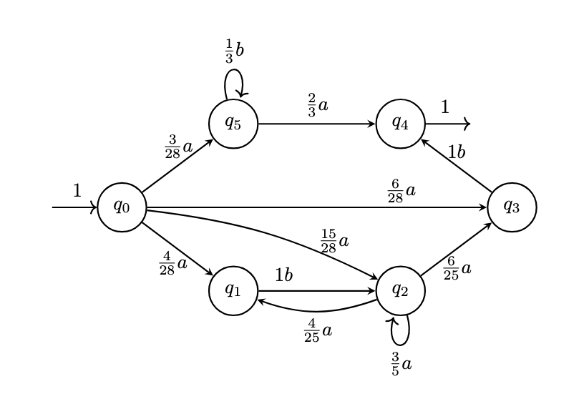
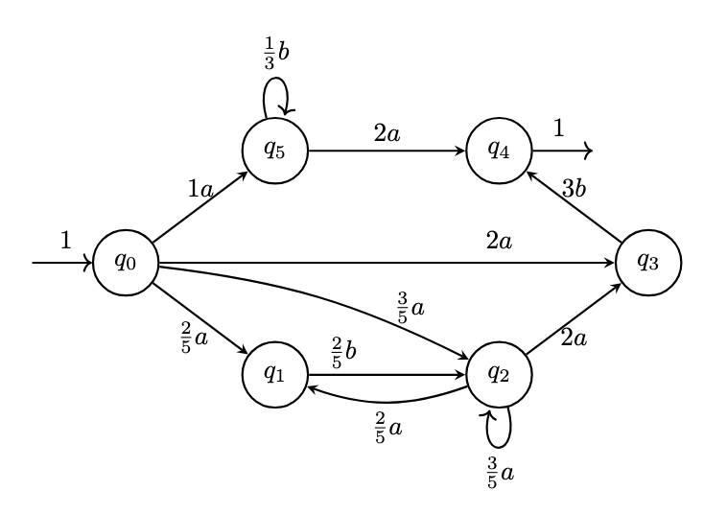
Our Research

Slide 69
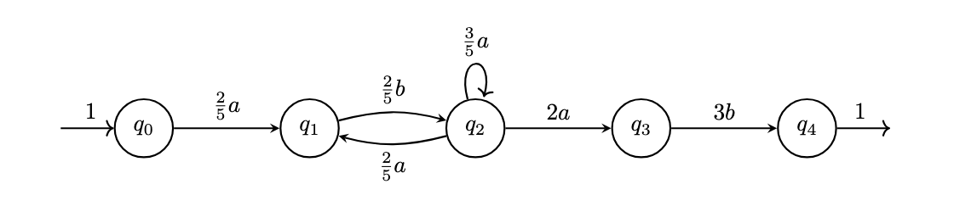
Our Research

Slide 70
Our Research
$$A=\left(\begin{matrix}0 & \frac{2}{5} \\ \frac{2}{5} & \frac{3}{5}\end{matrix}\right)λ=\left(\begin{aligned}0 \\ 2\end{aligned}\right)(I-A)^{-1}λ=\left(\begin{aligned}\frac{10}{3} \\ \frac{25}{3}\end{aligned}\right)$$
$$D=\text{diag}\left(\frac{10}{3},\frac{25}{3}\right)=\left(\begin{matrix}\frac{10}{3} & 0 \\ 0 & \frac{25}{3}\end{matrix}\right)D^{-1}=\left(\begin{matrix}\frac{3}{10} & 0 \\ 0 & \frac{3}{25}\end{matrix}\right)D^{-1}AD=\left(\begin{matrix}\frac{3}{10} & 0 \\ 0 & \frac{3}{25}\end{matrix}\right)\left(\begin{matrix}0 & \frac{2}{5} \\ \frac{2}{5} & \frac{3}{5}\end{matrix}\right)\left(\begin{matrix}\frac{10}{3} & 0 \\ 0 & \frac{25}{3}\end{matrix}\right)=\left(\begin{matrix}0 & 1 \\ \frac{4}{25} & \frac{3}{5}\end{matrix}\right)$$

Slide 71
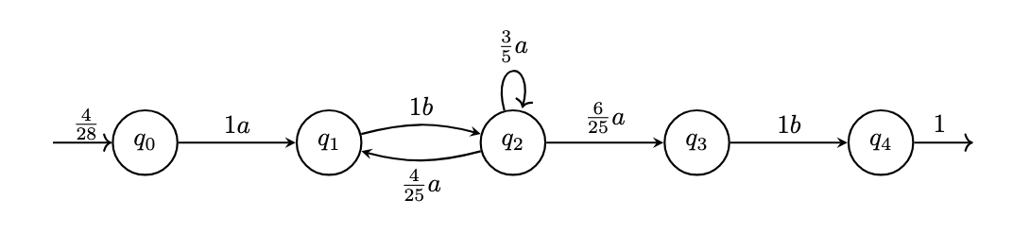
Our Research

Slide 72
Our Research
$$\frac{4}{28}(ab(\frac{4}{19}ab+\frac{15}{19}a)_{\frac{19}{25}}^{*})ab$$

Slide 73
Our Research
Any weighted automaton decomposes as $f(w)=ζ^{|w|}⋅Z⋅N(w)$
ζ = exponential growth rate
Z = scaling constant
⟦R⟧ = stochastic regular expression

Slide 74
Matrix Multiplication Algorithms
$$M_{a}=\left(\begin{matrix}0 & 2 & 0 & 2 & 0 \\ 0 & 0 & 0 & 0 & 3 \\ 0 & 0 & 0 & 0 & 1 \\ 0 & 0 & 0 & 0 & 5 \\ 0 & 0 & 0 & 0 & 0\end{matrix}\right).$$
$$M_{b}=\left(\begin{matrix}0 & 0 & 0 & 3 & 0 \\ 0 & 0 & 2 & 0 & 0 \\ 0 & 0 & 0 & 0 & 0 \\ 0 & 0 & 0 & 0.5 & 0 \\ 0 & 0 & 0 & 0 & 0\end{matrix}\right).$$
$$q_{1}$$
$$b/2$$
$$q_{2}$$
$$a/1$$
$$a/2$$
$$1$$
$$q_{0}$$
$$a/3$$
$$q_{4}$$
$$2$$
$$q_{3}$$
$$μ=\left(\begin{matrix}1 & 0 & 0 & 0 & 0\end{matrix}\right),λ=\left(\begin{aligned}0 \\ 0 \\ 0 \\ 0 \\ 2\end{aligned}\right).$$
$$a/2$$
$$a/5$$
$$b/3$$
$$b/{0.5}$$

Slide 75
Matrix Multiplication Algorithms
Let us now use this formulation to calculate the weight of some words:
$$A(aba)=μ⋅M_{a}⋅M_{b}⋅M_{a}⋅λ$$
$$\left(\begin{matrix}1 & 0 & 0 & 0 & 0\end{matrix}\right)⋅\left(\begin{matrix}0 & 2 & 0 & 2 & 0 \\ 0 & 0 & 0 & 0 & 3 \\ 0 & 0 & 0 & 0 & 1 \\ 0 & 0 & 0 & 0 & 5 \\ 0 & 0 & 0 & 0 & 0\end{matrix}\right)⋅\left(\begin{matrix}0 & 0 & 0 & 3 & 0 \\ 0 & 0 & 2 & 0 & 0 \\ 0 & 0 & 0 & 0 & 0 \\ 0 & 0 & 0 & β & 0 \\ 0 & 0 & 0 & 0 & 0\end{matrix}\right)⋅\left(\begin{matrix}0 & 2 & 0 & 2 & 0 \\ 0 & 0 & 0 & 0 & 3 \\ 0 & 0 & 0 & 0 & 1 \\ 0 & 0 & 0 & 0 & 5 \\ 0 & 0 & 0 & 0 & 0\end{matrix}\right)⋅\left(\begin{aligned}0 \\ 0 \\ 0 \\ 0 \\ 2\end{aligned}\right)$$
$$b/2$$
$$q_{1}$$
$$q_{2}$$
$$a/1$$
$$a/2$$
$$1$$
$$q_{0}$$
$$a/3$$
$$q_{4}$$
$$2$$
$$q_{3}$$
$$a/2$$
$$a/5$$
$$b/3$$
$$b/{0.5}$$

